Slide 1

Accessing AWS DynamoDB from EC2 using Python script from VSCode
Ankita Phadke
04/13/23

Slide 2
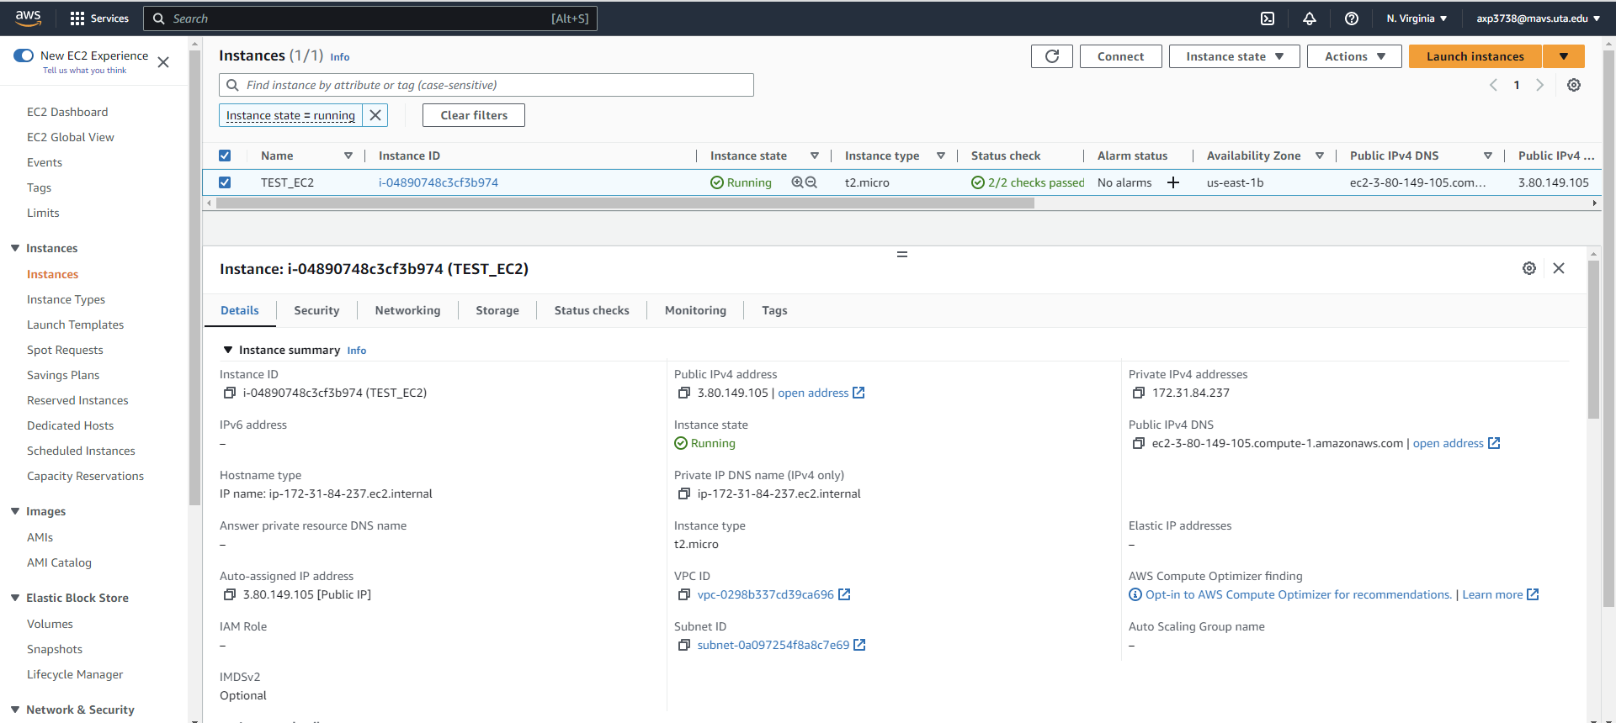
Accessing DynamoDB from EC2 using Python (VSCode)
Power on the EC2 created previously, note the public IP address
Inside AWS

Slide 3
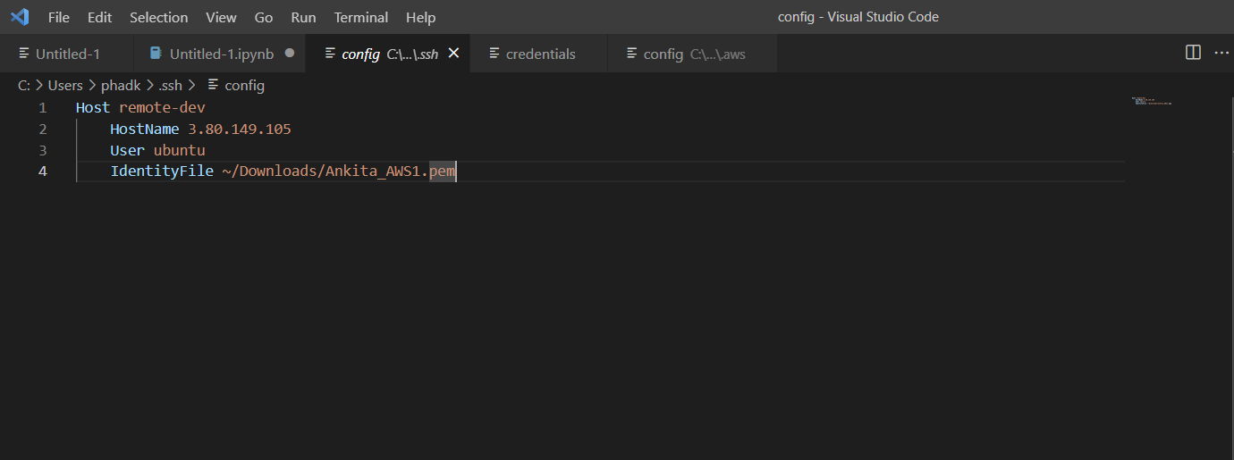
Accessing DynamoDB from EC2 using Python (VSCode)
Update EC2 public IP address in SSH config file (VSCode has IAM user configured)
Inside VSCode

Slide 4
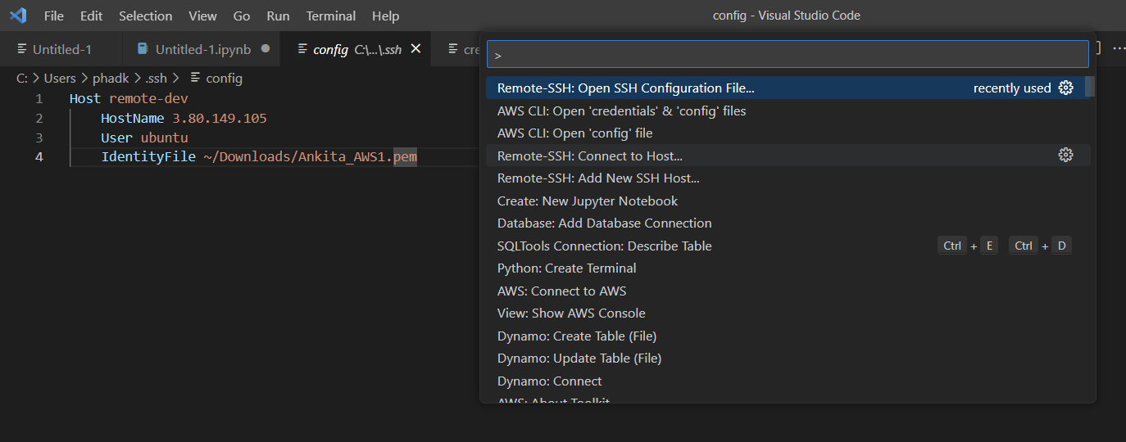
Accessing DynamoDB from EC2 using Python (VSCode)
View> Command palette> Remote-SSH: Connect to Host..
Inside VSCode

Slide 5
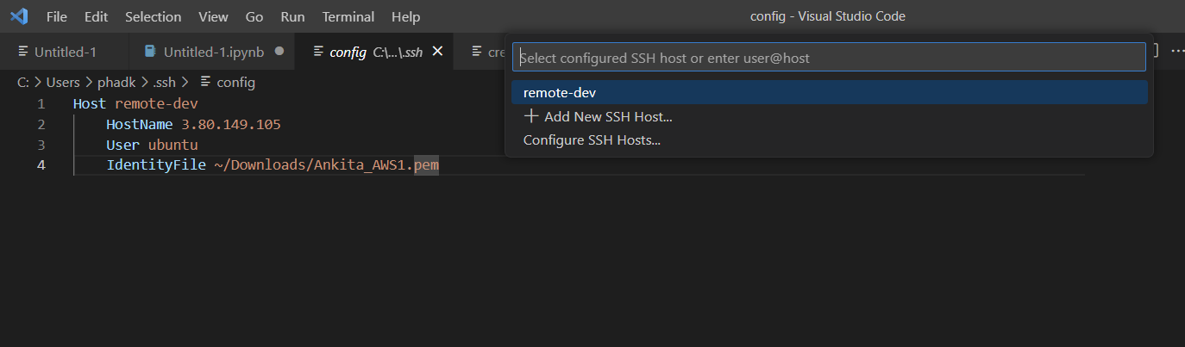
Accessing DynamoDB from EC2 using Python (VSCode)
Select the saved SSH Host from the config file – remote-dev in this case
Inside VSCode

Slide 6
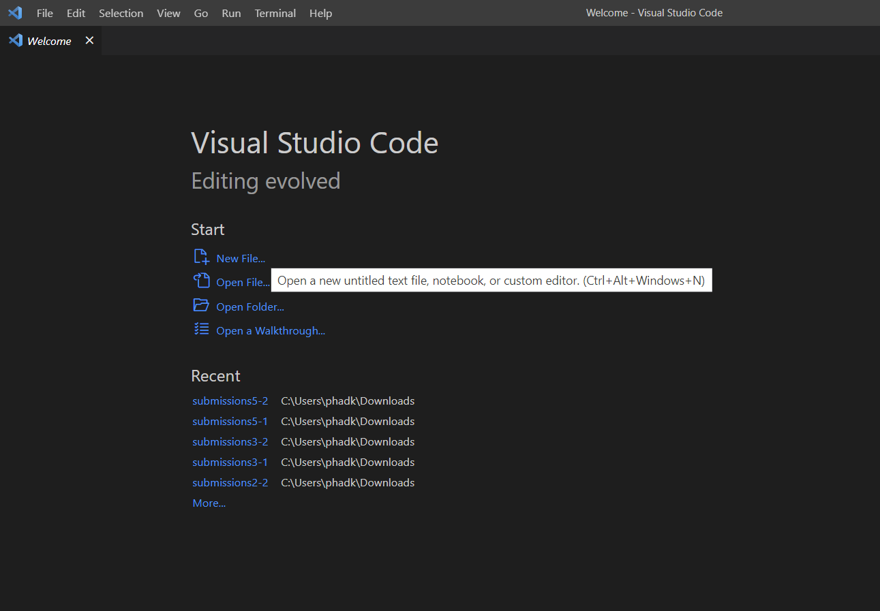
Accessing DynamoDB from EC2 using Python (VSCode)
New window opens, click on New File to create a new file
Inside VSCode

Slide 7
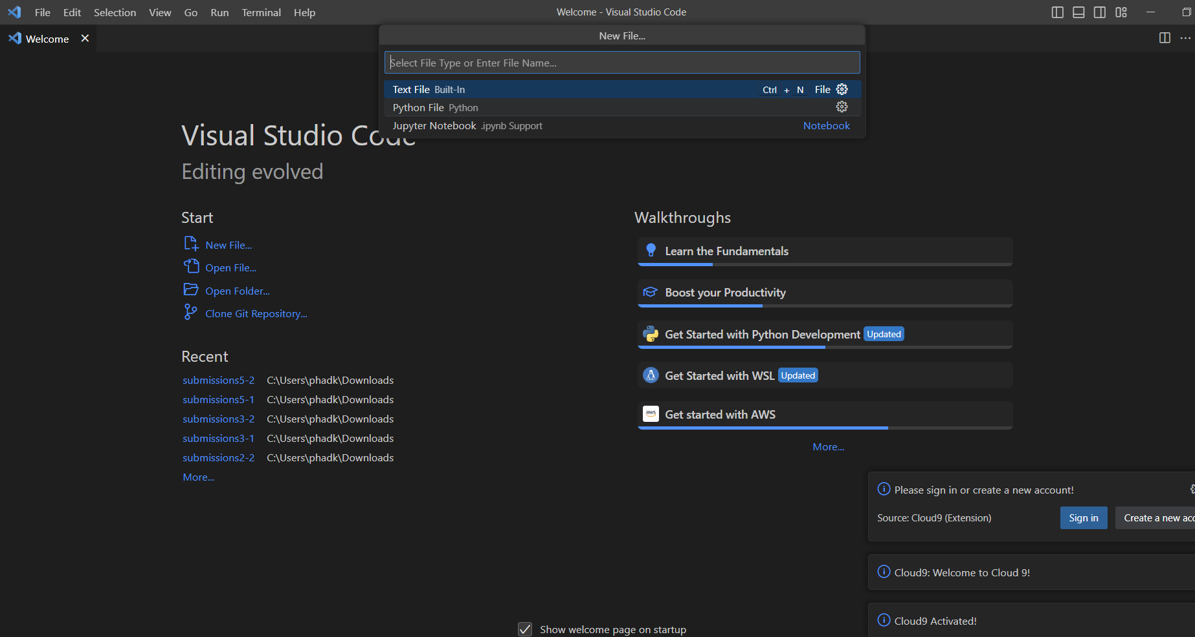
Accessing DynamoDB from EC2 using Python (VSCode)
Select ‘Python’ option to create new Python file
Inside VSCode

Slide 8
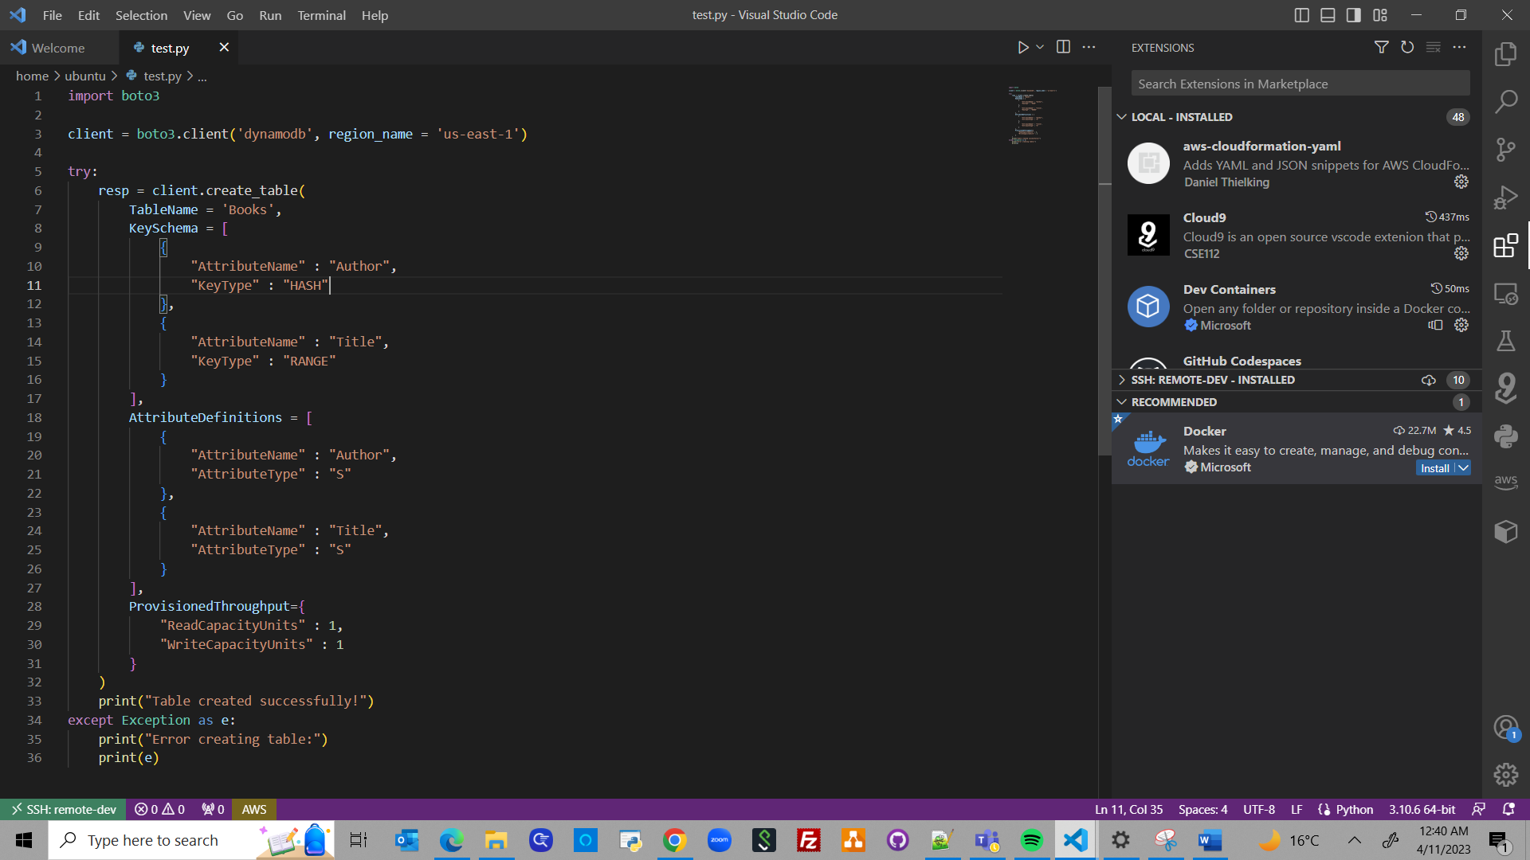
Accessing DynamoDB from EC2 using Python (VSCode)
Created test.py file to create new DynamoDB table: Books
Inside VSCode

Slide 9
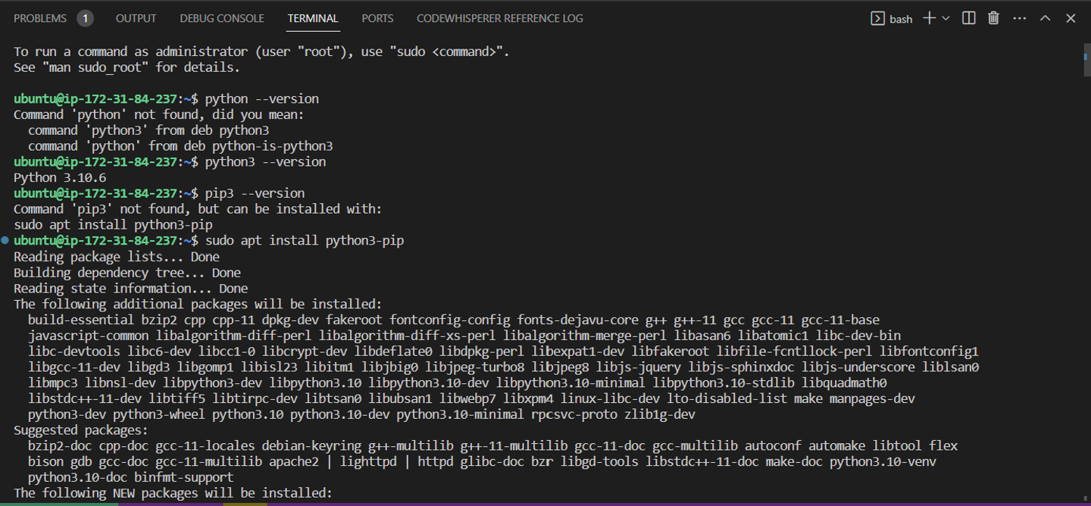
Accessing DynamoDB from EC2 using Python (VSCode)
Opened new terminal in EC2 and ran below four commands
Inside VSCode
python3 --version → found Python 3.10.6 already installed
sudo apt install python3-pip → installation started

Slide 10
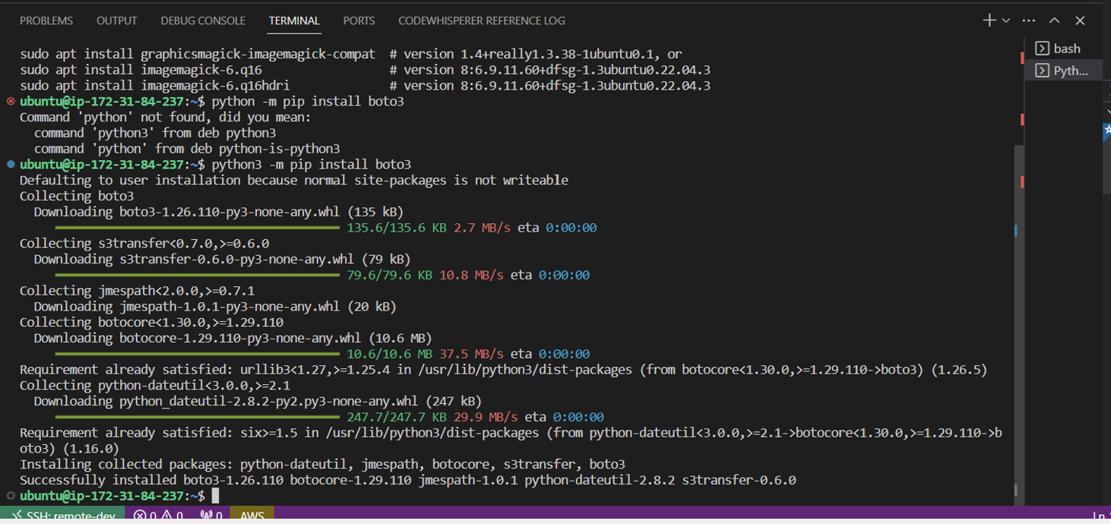
Accessing DynamoDB from EC2 using Python (VSCode)
Continued the next commands in same terminal
Inside VSCode
3. python3 –m pip install boto3 → installation started

Slide 11
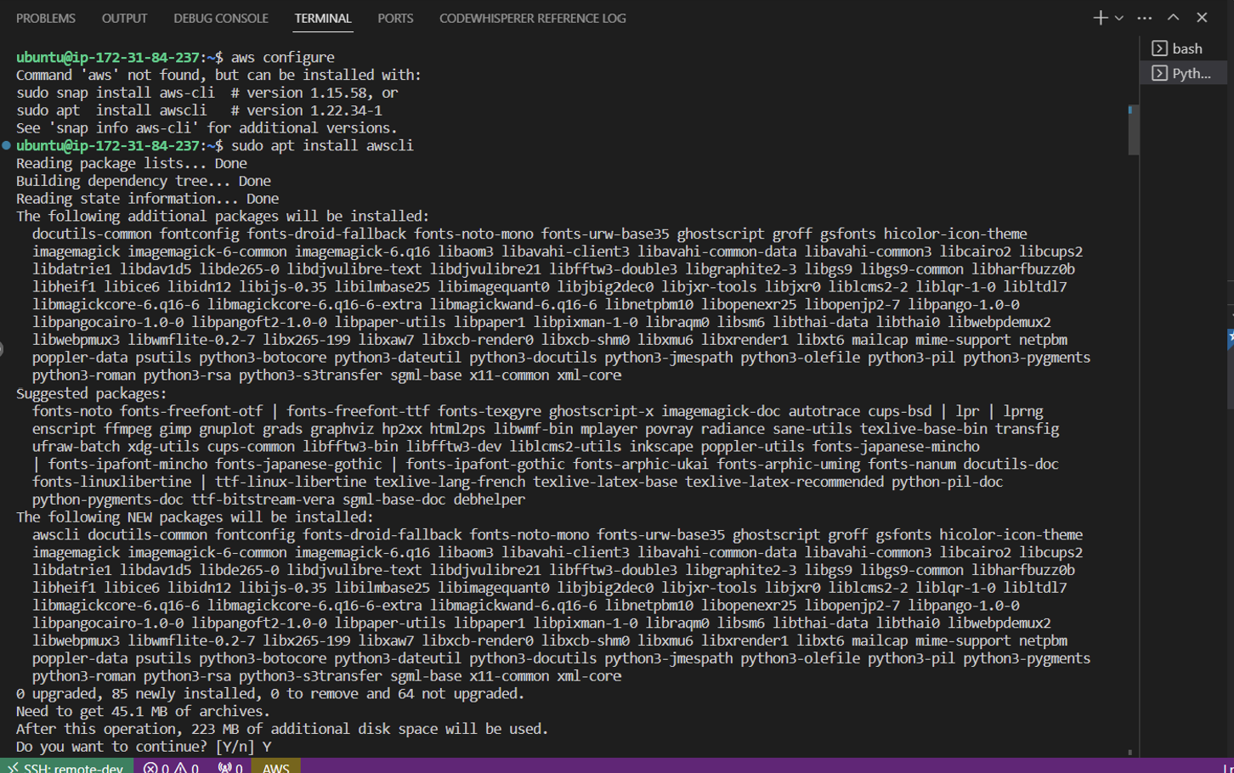
Accessing DynamoDB from EC2 using Python (VSCode)
Continued the next commands in same terminal
Inside VSCode
4. sudo apt install awscli → installation started

Slide 12
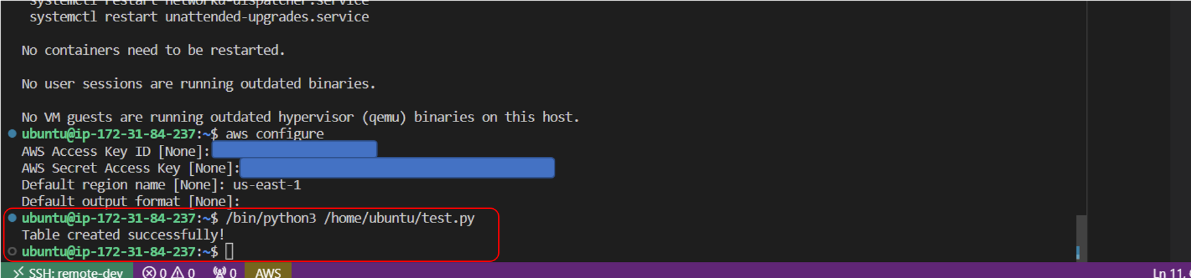
Accessing DynamoDB from EC2 using Python (VSCode)
Ran the test.py file to create new table
Inside VSCode

Slide 13
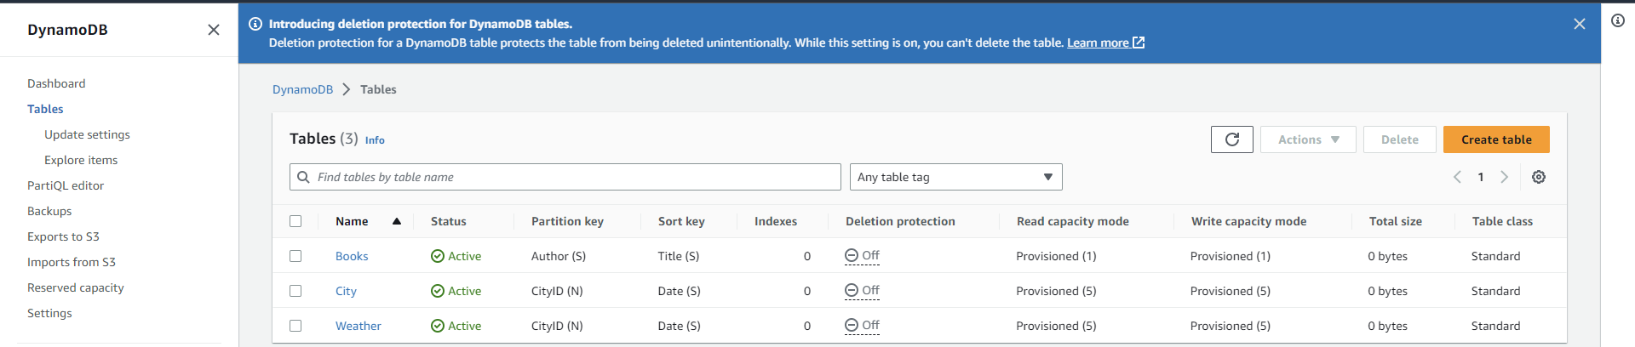
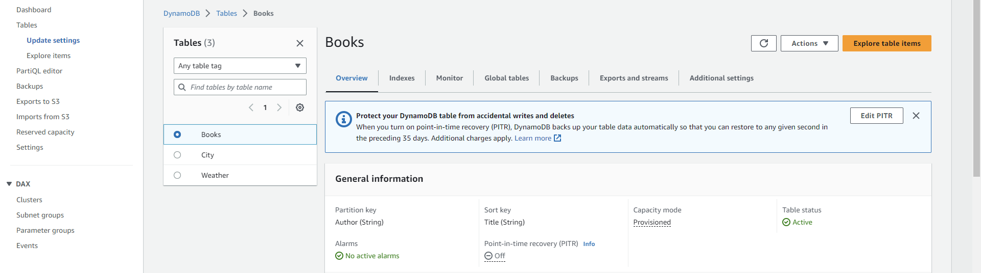
Accessing DynamoDB from EC2 using Python (VSCode)
Confirmed if the table was created in DynamoDB
Inside AWS

Slide 14
References:
https://docs.aws.amazon.com/toolkit-for-vscode/latest/userguide/connect.html
https://dev.to/cindyledev/remote-development-with-visual-studio-code-on-aws-ec2-4cla
https://docs.aws.amazon.com/amazondynamodb/latest/developerguide/DAX.client.run-application-python.01-create-table.html

